Slide 1

Energy Load Forecasting for approved energy
BHAVESH THAKKAR
MS DATA ANALYTICS ENGINEERING | NU 2021

Slide 2
Content
Load forecasting challenges & solution
Weather and energy load demand patterns
Multi linear regression modelling
Random forest regression modelling
Future scope

Slide 3
Challenge and solution
Energy load forecasting is one of the most challenging field.
Traditionally, load forecasting relied upon weather as one of the important feature. Models like multiple linear regression were very helpful for predicting the energy load.
However, with help of new machine learning algorithms there is a huge scope of improving forecasting.
Beyond the forecasting techniques with the help of new data beyond weather overall load forecasting accuracy can be significantly improved.

Slide 4
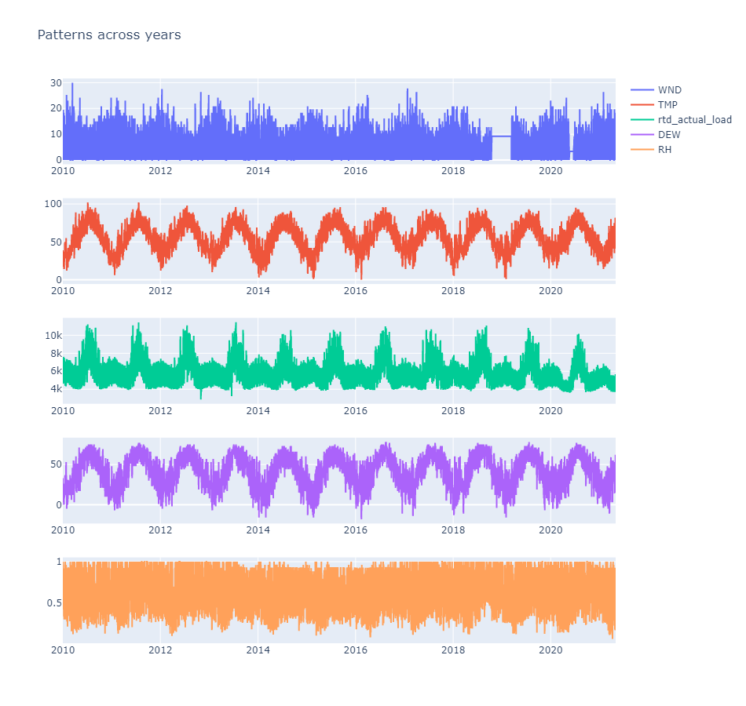
WEATHER AND LOAD TRENDS FOR 2010-2021
Energy demand usually peaks up during the summer months.
Weather characteristics like temperature, humidity, and wind can be used as a factor to understand forecast load in a better manner.

Slide 5
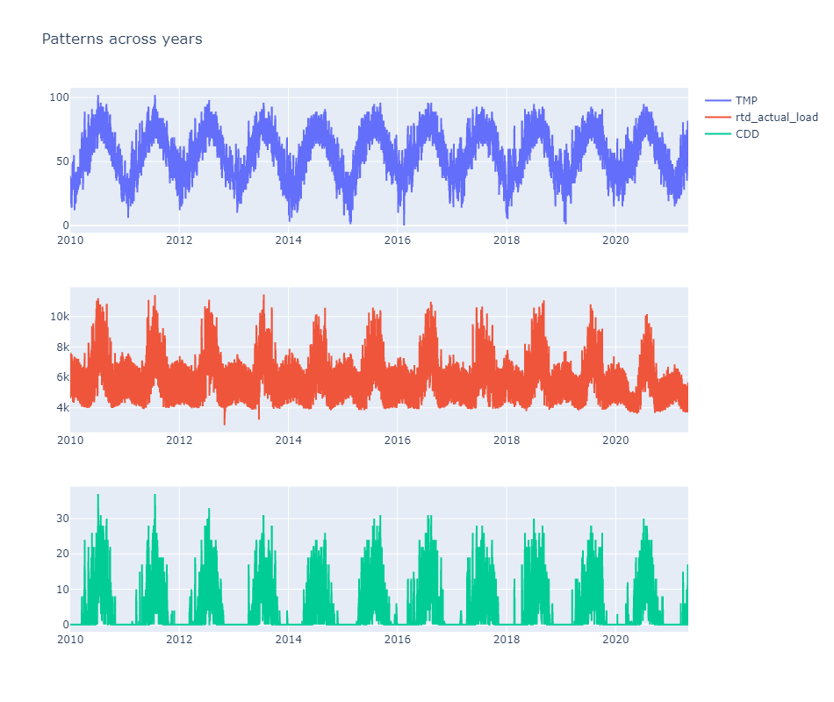
WEATHER AND LOAD TRENDS FOR 2010-2021
Cooling degree days (CDD)are the temperature beyond which humans usually starts feeling uncomfortable.
Cooling degree days have a significant impact on energy consumption.

Slide 6
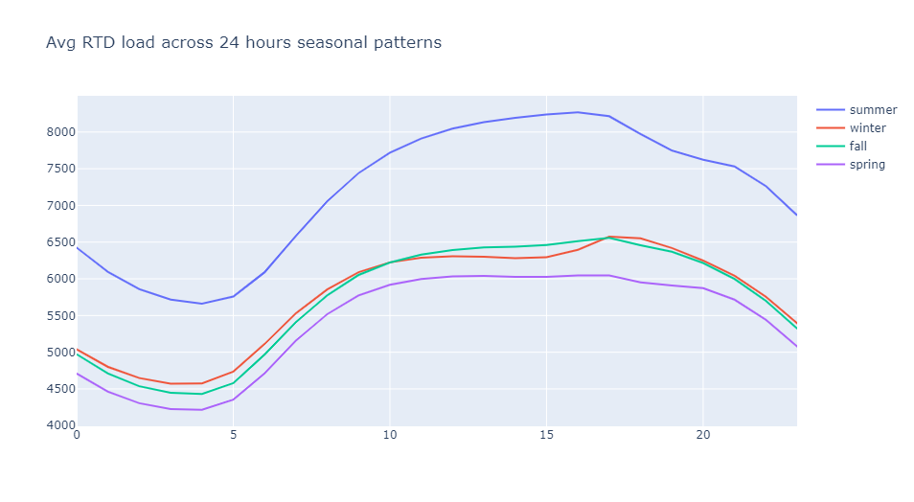
WEATHER AND LOAD TRENDS FOR 2010-2021
Beyond weather there is a trend on how the energy load varies throughout the day.
However, summer months still play a huge role in energy demand.

Slide 7
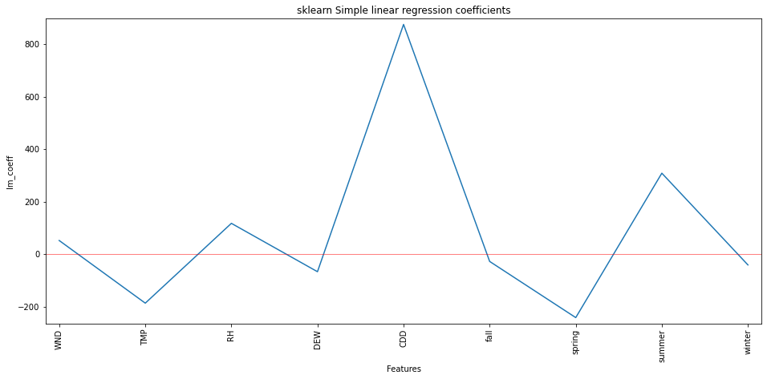
Regression Analysis
Load forecasting with Multi Linear Regression analysis shows how important are the weather features like Cooling degree days and the summer. But beyond that weather characteristics like humidity also plays a significant role in forecasting the energy load.
The forecasting accuracy on basis of regression analysis was around 47%. Indicating there is a significant influence of weather on energy usage.

Slide 8
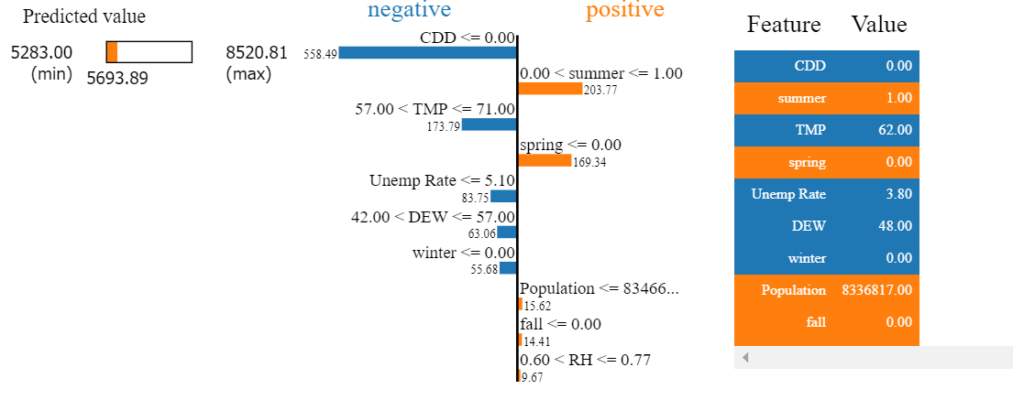
Random Forest
Regression analysis shows the importance of weather on load forecasting.
However, adding features like population and unemployment improves the forecasting accuracy by 5%.
This shows that there are variables at play beyond weather to understand and forecast energy demand.

Slide 9
Future Scope
There are various ways load forecasting can be improved. Additional features like settlement prices, can improve the current random forest model.
With the help of new machine learning algorithms and, overall forecasting accuracy can be further improved.
There are various ways to interpret Blackbox models like neural networks and boosting algorithms. Traditional forecasting relied upon use of simpler algorithms like linear regression.

